Slide 1
List arrays and Skiplists
CMSC 420

Slide 2
Central question
How can I do binary search in a sorted linked list?

Slide 3
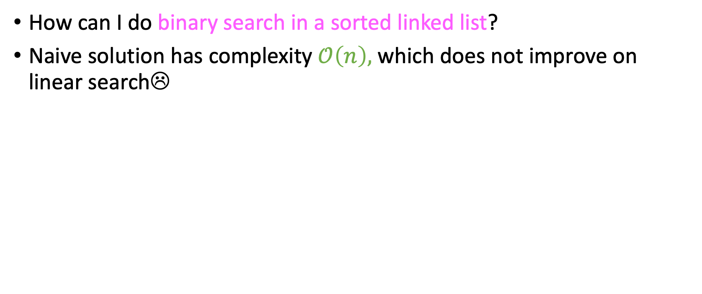
Central question
How can I do binary search in a sorted linked list?
Naive solution has complexity $𝒪\left(n\right),$ which does not improve on linear search☹

Slide 4
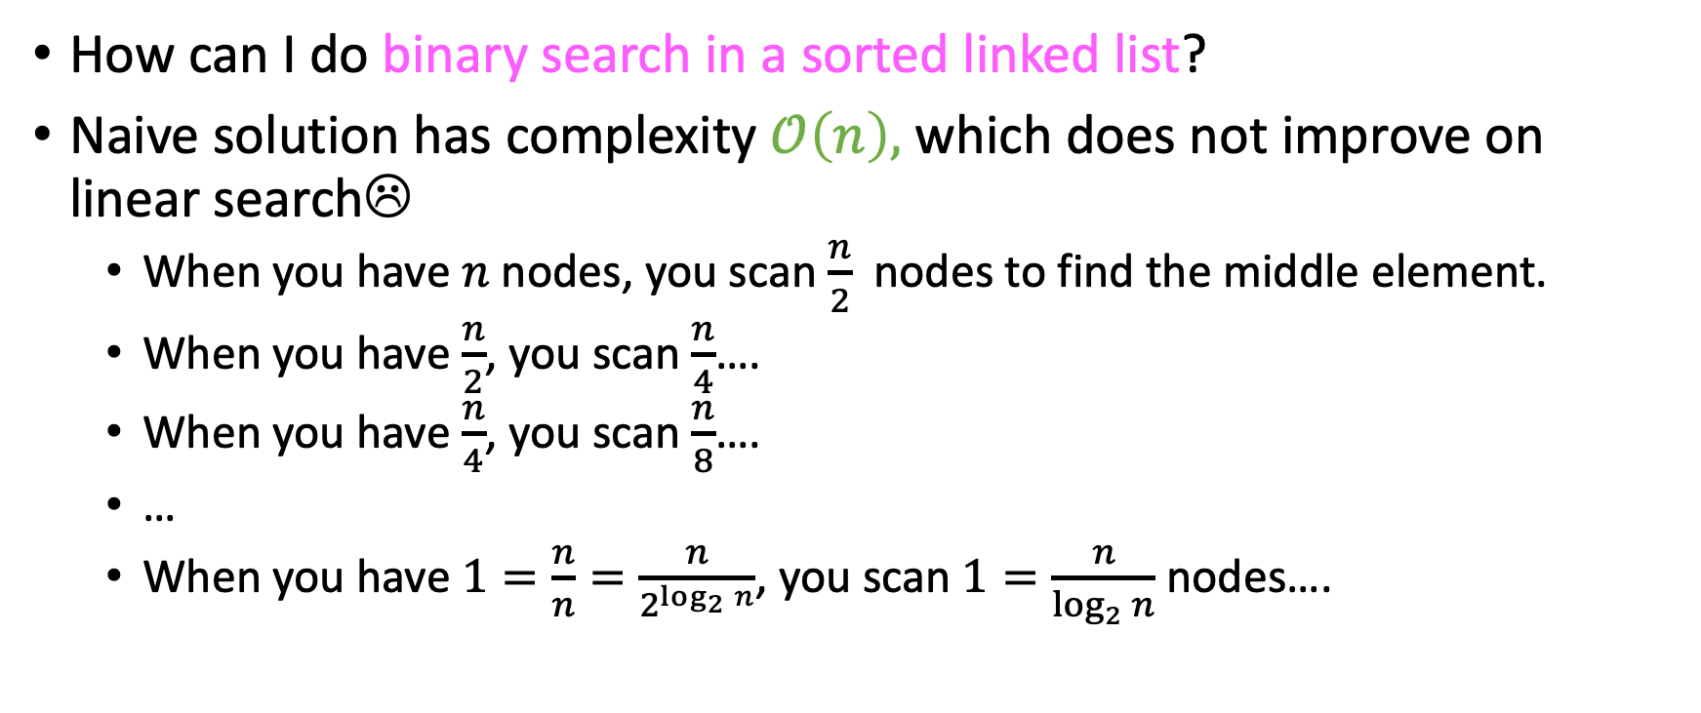
Central question
How can I do binary search in a sorted linked list?
Naive solution has complexity $𝒪\left(n\right),$ which does not improve on linear search☹
When you have $n$ nodes, you scan $\frac{n}{2}$ nodes to find the middle element.
When you have $\frac{n}{2}$, you scan $\frac{n}{4}$….
When you have $\frac{n}{4}$, you scan $\frac{n}{8}$….
…
When you have $1=\frac{n}{n}=\frac{n}{2^{\log_{2}{n}}}$, you scan $1=\frac{n}{\log_{2}{n}}$ nodes….

Slide 5

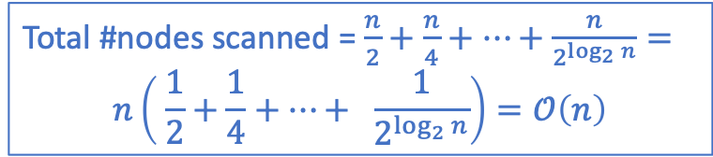
Central question
How can I do binary search in a sorted linked list?
Naive solution has complexity $𝒪\left(n\right),$ which does not improve on linear search☹
When you have $n$ nodes, you scan $\frac{n}{2}$ nodes to find the middle element.
When you have $\frac{n}{2}$, you scan $\frac{n}{4}$….
When you have $\frac{n}{4}$, you scan $\frac{n}{8}$….
…
When you have $\frac{n}{2^{\log_{2}{n}}}$, you scan $\frac{n}{n}=1$ nodes….
Total #nodes scanned = $\frac{n}{2}+\frac{n}{4}+…+\frac{n}{2^{\log_{2}{n}}}=$ $$n\left( \frac{1}{2}+\frac{1}{4}+…+ \frac{1}{2^{\log_{2}{n}}}\right)=𝒪\left(n\right)$$

Slide 6
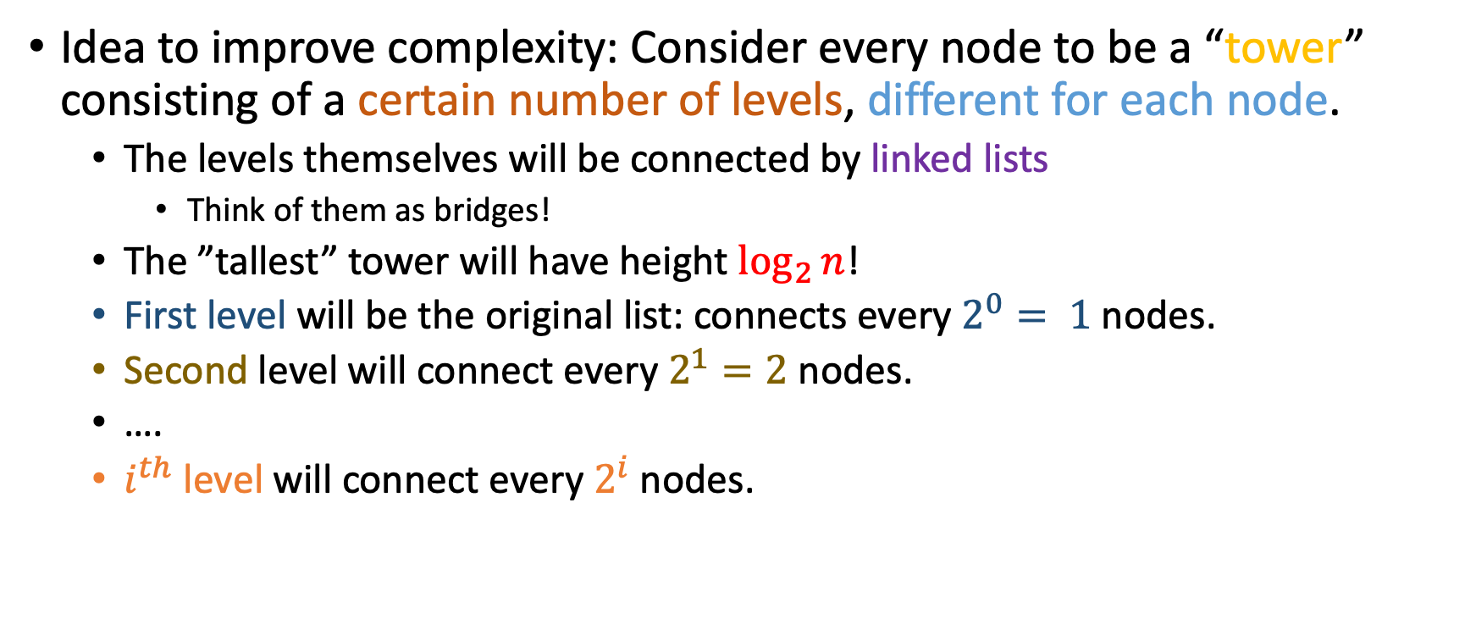
Central question
Idea to improve complexity: Consider every node to be a “tower” consisting of a certain number of levels, different for each node.
The levels themselves will be connected by linked lists
Think of them as bridges!
The ”tallest” tower will have height $\log_{2}{n}$!
First level will be the original list: connects every $2^{0}= 1$nodes.
Second level will connect every $2^{1}=2$ nodes.
….
$i^{th}$ level will connect every $2^{i}$ nodes.

Slide 7
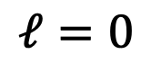
List Arrays
3
2
1
0
5
8
11
15
20
22
30
33
$$ℓ=0$$
“header” node
null

Slide 8
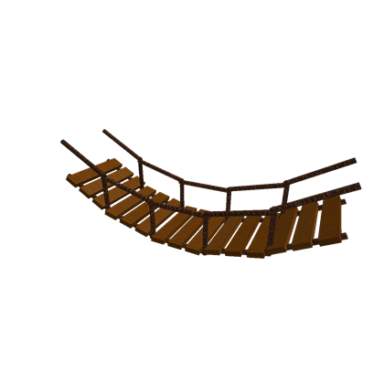

List Arrays
3
2
1
0
5
8
11
15
20
22
30
33
$$ℓ=0$$
“header” node
null

Slide 9
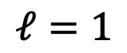
List Arrays
3
2
1
0
8
15
22
33
$$ℓ=1$$
5
11
20
30
$$ℓ=0$$
“header” node
null

Slide 10
List Arrays
Second level ($ℓ=1)$ connects every 2^1 = 2 nodes!
3
2
1
0
2 nodes
2 nodes
2 nodes
2 nodes
8
15
22
33
$$ℓ=1$$
5
11
20
30
$$ℓ=0$$
“header” node
null

Slide 11
List Arrays
3
2
1
0
8
15
22
33
$$ℓ=1$$
5
11
20
30
$$ℓ=0$$
“header” node
null

Slide 12
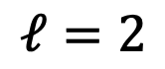
List Arrays
3
2
1
0
15
33
$$ℓ=2$$
8
22
$$ℓ=1$$
5
11
20
30
$$ℓ=0$$
“header” node
null

Slide 13
List Arrays
Third level ($ℓ=2)$ connects every 2^2 = 4 nodes!
3
2
1
0
4 nodes
4 nodes
15
33
$$ℓ=2$$
8
22
$$ℓ=1$$
5
11
20
30
$$ℓ=0$$
“header” node
null

Slide 14

List Arrays
3
2
1
0
15
33
$$ℓ=2$$
8
22
$$ℓ=1$$
5
11
20
30
$$ℓ=0$$
“header” node
null

Slide 15
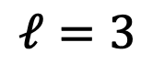
List Arrays
3
2
1
0
33
$$ℓ=3$$
15
$$ℓ=2$$
8
22
$$ℓ=1$$
5
11
20
30
$$ℓ=0$$
“header” node
null

Slide 16
List Arrays
Fourth level ($ℓ=3)$ connects every 2^3 = 8 nodes!
8 nodes
3
2
1
0
33
$$ℓ=3$$
15
$$ℓ=2$$
8
22
$$ℓ=1$$
5
11
20
30
$$ℓ=0$$
“header” node
null

Slide 17
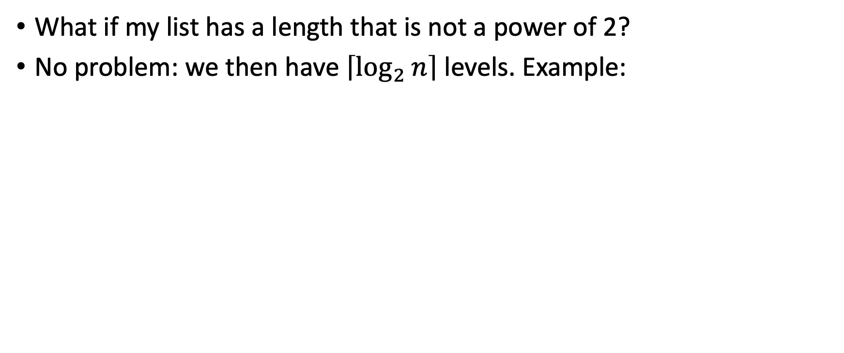

Extension to other lengths
What if my list has a length that is not a power of 2?
No problem: we then have $\left\lceil \log_{2}{n}\right\rceil$ levels. Example:
$$(n=6)⇒(\left\lceil \log_{2}{n}\right\rceil =3)$$
2
1
0
18
11
23
8
15
21
null

Slide 18
Searching a list array
Every one of the individual arrays has the data element stored at position 0.
Searching works as follows:
Βegin at header[levels – 1]. Traverse the current level until:
You find the element (search hit, congrats)
You find a tower whose element is greater, or:
You hit null.
If either (b) or (c) happens, descend to the level below and goto (1).
If there is no level below, you have a search miss. At this point you should consider how this makes you feel.

Slide 19
Search example
Search for “20” – should be a successful search
3
2
1
0
33
$$ℓ=3$$
15
$$ℓ=2$$
8
22
$$ℓ=1$$
5
11
20
30
$$ℓ=0$$
null

Slide 20
Search example
Start at header[levels-1]…
3 | 1
2
1
0
33
$$ℓ=3$$
15
$$ℓ=2$$
8
22
$$ℓ=1$$
5
11
20
30
$$ℓ=0$$
null

Slide 21


Search example
The pointer points to a tower with element greater than 20
3 | 1
2
1
0
33
$$ℓ=3$$
15
$$ℓ=2$$
8
22
$$ℓ=1$$
5
11
20
30
$$ℓ=0$$
null

Slide 22

Search example
Solution: decrease your level!
3 | 1
2 | 2
1
0
33
$$ℓ=3$$
15
$$ℓ=2$$
8
22
$$ℓ=1$$
5
11
20
30
$$ℓ=0$$
null

Slide 23
Search example
Dereference pointer.
3 | 1
2 | 2
1
0
33
$$ℓ=3$$
3
15
$$ℓ=2$$
8
22
$$ℓ=1$$
5
11
20
30
$$ℓ=0$$
null

Slide 24
Search example
Key (15) smaller than desired key (20)
3 | 1
2 | 2
1
0
33
$$ℓ=3$$
3
15
$$ℓ=2$$
8
22
$$ℓ=1$$
5
11
20
30
$$ℓ=0$$
null

Slide 25

Search example
So keep going on the same level!
3 | 1
2 | 2
1
0
33
$$ℓ=3$$
3
15
$$ℓ=2$$
8
22
$$ℓ=1$$
5
11
20
30
$$ℓ=0$$
null

Slide 26

Search example
Contained key (33) greater than sought key (20) again!
3 | 1
2 | 2
1
0
33
$$ℓ=3$$
3
15
$$ℓ=2$$
8
22
$$ℓ=1$$
5
11
20
30
$$ℓ=0$$
null

Slide 27

Search example
So descend a level again!
3 | 1
2 | 2
1
0
33
$$ℓ=3$$
3
4
15
$$ℓ=2$$
8
22
$$ℓ=1$$
5
11
20
30
$$ℓ=0$$
null

Slide 28

Search example
Dereferencing pointer leads us to a tower with a key too big…
3 | 1
2 | 2
1
0
33
$$ℓ=3$$
3
4
15
$$ℓ=2$$
8
22
$$ℓ=1$$
5
11
20
30
$$ℓ=0$$
null

Slide 29

Search example
So descend another level…
3 | 1
2 | 2
1
0
33
$$ℓ=3$$
3
4
5 15
$$ℓ=2$$
8
22
$$ℓ=1$$
5
11
20
30
$$ℓ=0$$
null

Slide 30

Search example
Final pointer dereference gives us our key. Search hit.
3 | 1
2 | 2
1
0
33
$$ℓ=3$$
3
4
5 15
$$ℓ=2$$
8
22
$$ℓ=1$$
6
20
5
11
30
$$ℓ=0$$
null

Slide 31
Another search example – for you!
For the same list array, sequentially mark the nodes traversed by searching for 9 (nine), which should fail!
3
2
1
0
33
$$ℓ=3$$
15
$$ℓ=2$$
8
22
$$ℓ=1$$
5
11
20
30
$$ℓ=0$$
null

Slide 32
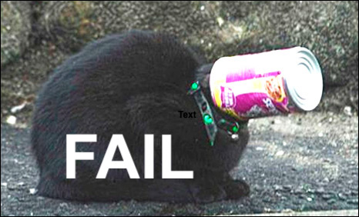
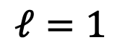
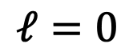
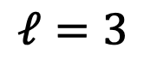
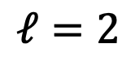
Solution
3 | 1
2 | 2
1 | 3
0
33
$$ℓ=3$$
15
$$ℓ=2$$
4
5 8
22
$$ℓ=1$$
5
11
20
30
$$ℓ=0$$
null

Slide 33
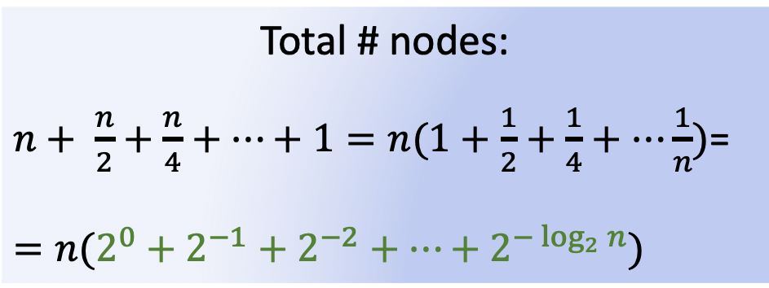
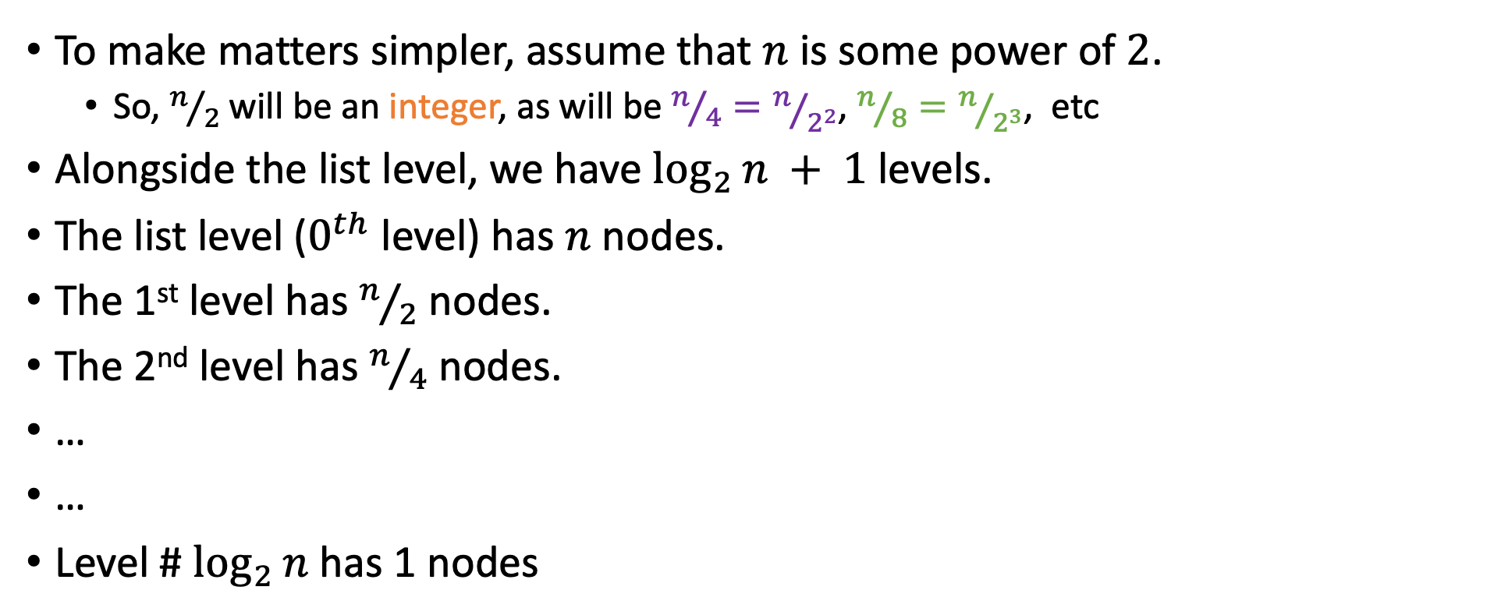
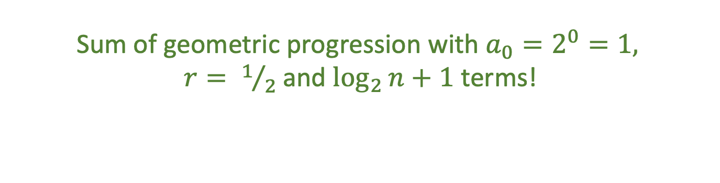
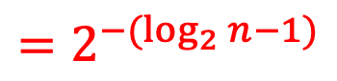
Space analysis
To make matters simpler, assume that $n$ is some power of $2$.
So, $n/2$ will be an integer, as will be $n/4=n/{2^{2}}$, $n/8=n/{2^{3}}$, etc
Alongside the list level, we have $\log_{2}{n} + 1$levels.
The list level ($0^{th}$ level) has $n$ nodes.
The 1st level has $n/2$ nodes.
The 2nd level has $n/4$ nodes.
…
…
Level # $\log_{2}{n}$ has 1 nodes
$$=2^{−(\log_{2}{n}−1)}$$
Total # nodes:
$n+ \frac{n}{2}+\frac{n}{4}+…+1=n(1+\frac{1}{2}+\frac{1}{4}+…\frac{1}{n})$=
$$=n(2^{0}+2^{−1}+2^{−2}+…+2^{−\log_{2}{n}})$$
Sum of geometric progression with $a_{0}=2^{0}=1,$ $r= 1/2$ and $\log_{2}{n}+1$ terms!

Slide 34
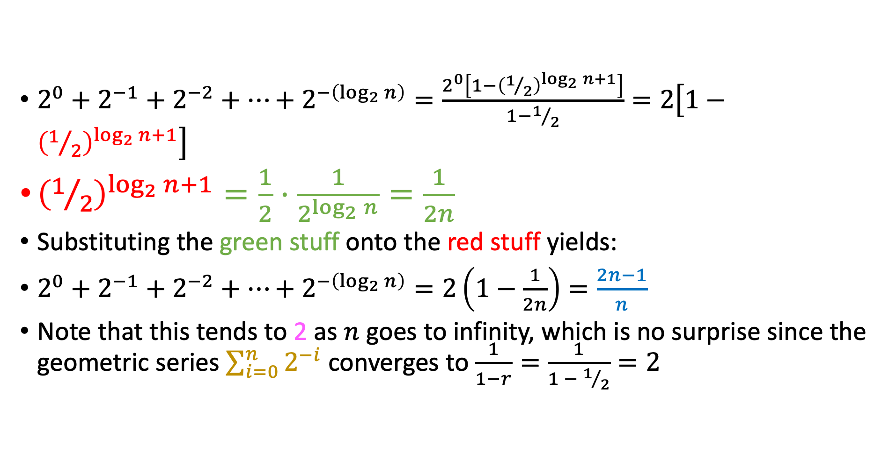
Unpacking the sum…
$2^{0}+2^{−1}+2^{−2}+…+2^{−\left(\log_{2}{n}\right)}=\frac{2^{0}\left[1−{\left(1/2\right)}^{\log_{2}{n+1}}\right]}{1−1/2}=2\left[1−{\left(1/2\right)}^{\log_{2}{n}+1}\right]$
${\left(1/2\right)}^{\log_{2}{n}+1}=\frac{1}{2}⋅\frac{1}{2^{\log_{2}{n}}}=\frac{1}{2n}$
Substituting the green stuff onto the red stuff yields:
$2^{0}+2^{−1}+2^{−2}+…+2^{−\left(\log_{2}{n}\right)}=2\left(1−\frac{1}{2n}\right)=\frac{2n−1}{n}$
Note that this tends to 2 as $n$ goes to infinity, which is no surprise since the geometric series $\sum_{i=0}^{n}{2^{−i}}$ converges to $\frac{1}{1−r}=\frac{1}{1 − 1/2}=2$

Slide 35
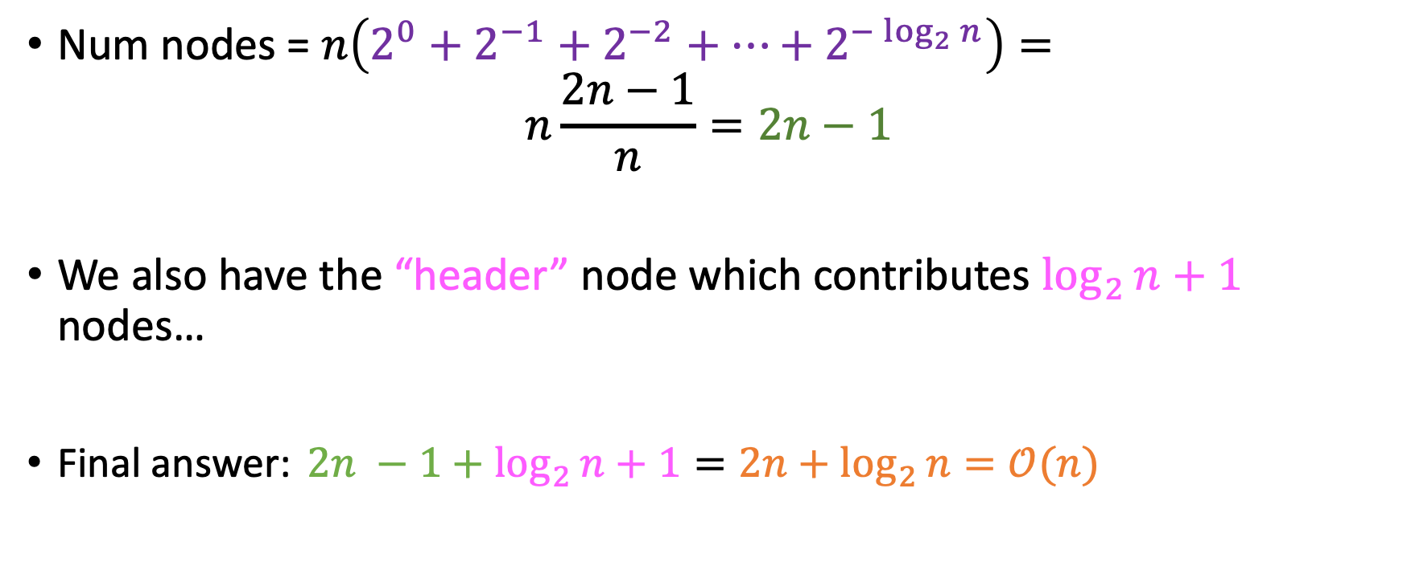
Final answer
Num nodes = $n\left(2^{0}+2^{−1}+2^{−2}+…+2^{−\log_{2}{n}}\right)=$ $n\frac{2n−1}{n}=2n−1$
We also have the “header” node which contributes $\log_{2}{n}+1$ nodes…
Final answer: $2n −1+\log_{2}{n}+1=2n+\log_{2}{n}=𝒪(n)$

Slide 36
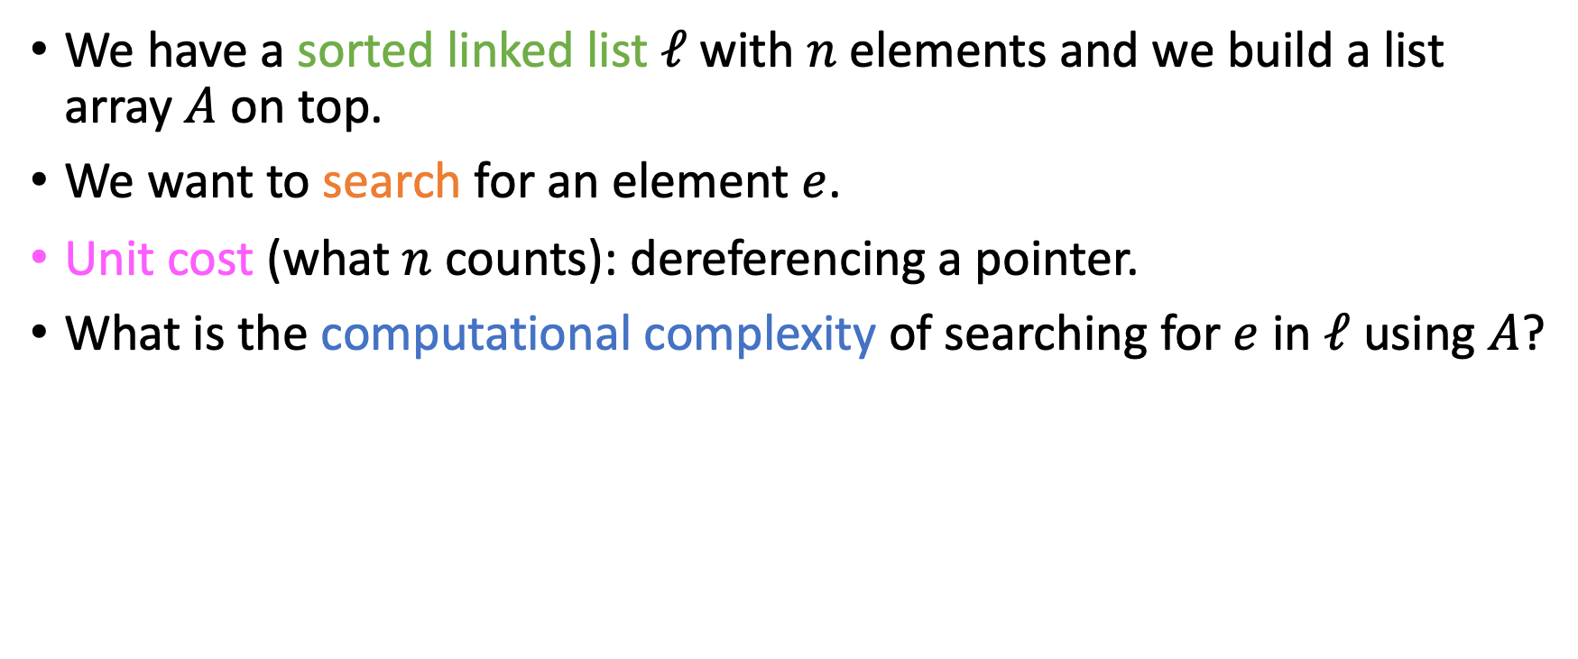
Search efficiency analysis
We have a sorted linked list $ℓ$ with $n$ elements and we build a list array $A$ on top.
We want to search for an element $e$.
Unit cost (what $n$ counts): dereferencing a pointer.
What is the computational complexity of searching for $e$ in $ℓ$ using $A$?

Slide 37
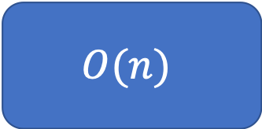

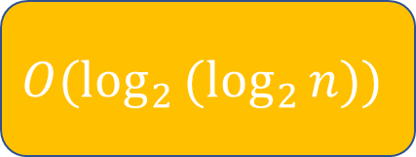
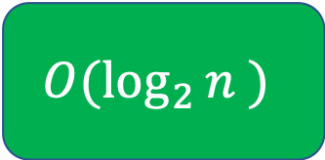
Search efficiency analysis
We have a sorted linked list $ℓ$ with $n$ elements and we build a list array $A$ on top.
We want to search for an element $e$.
Unit cost (what $n$ counts): dereferencing a pointer.
What is the computational complexity of searching for $e$ in $ℓ$ using $A$?
$$O(n)$$
$$O(\log_{2}{n} )$$
$$O(\log_{2}{(\log_{2}{n}}))$$
Something else (what?)

Slide 38
Search efficiency analysis
We have a sorted linked list $ℓ$ with $n$ elements and we build a list array $A$ on top.
We want to search for an element $e$.
Unit cost (what $n$ counts): dereferencing a pointer.
What is the computational complexity of searching for $e$ in $ℓ$ using $A$?
$$O(n)$$
$$O(\log_{2}{n} )$$
$$O(\log_{2}{(\log_{2}{n}}))$$
Something else (what?)
Now let’s determine the constant…

Slide 39
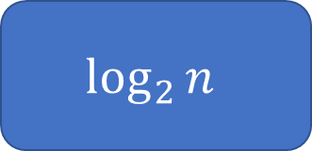
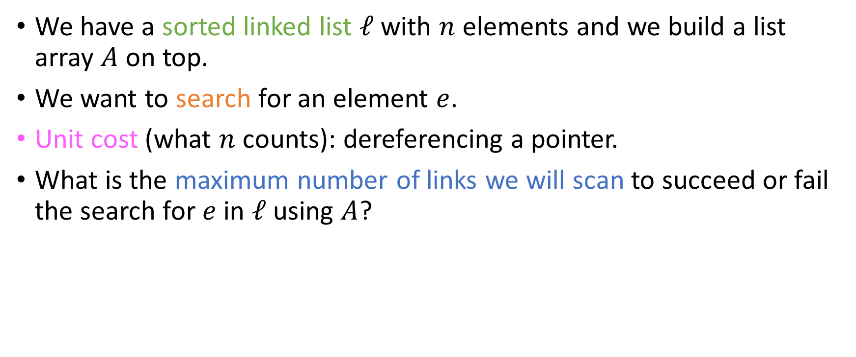
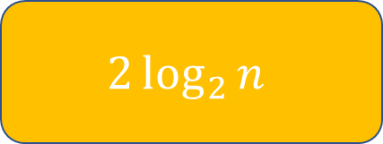
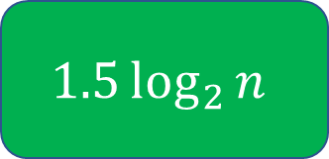
Search efficiency analysis
We have a sorted linked list $ℓ$ with $n$ elements and we build a list array $A$ on top.
We want to search for an element $e$.
Unit cost (what $n$ counts): dereferencing a pointer.
What is the maximum number of links we will scan to succeed or fail the search for $e$ in $ℓ$ using $A$?
$$\log_{2}{n}$$
$$1.5\log_{2}{n}$$
$$2\log_{2}{n}$$
Something else (what?)

Slide 40
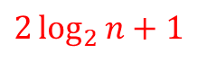
Search efficiency analysis
We have a sorted linked list $ℓ$ with $n$ elements and we build a list array $A$ on top.
We want to search for an element $e$.
Unit cost (what $n$ counts): dereferencing a pointer.
What is the maximum number of links we will scan to succeed or fail the search for $e$ in $ℓ$ using $A$?
$2\log_{2}{n}+1$
Also acceptable
$$\log_{2}{n}$$
$$1.5\log_{2}{n}$$
$$2\log_{2}{n}$$
Something else (what?)
At every level, we visit at most 2 nodes (why?) and at level 0 we might have one additional pointer dereference.

Slide 41
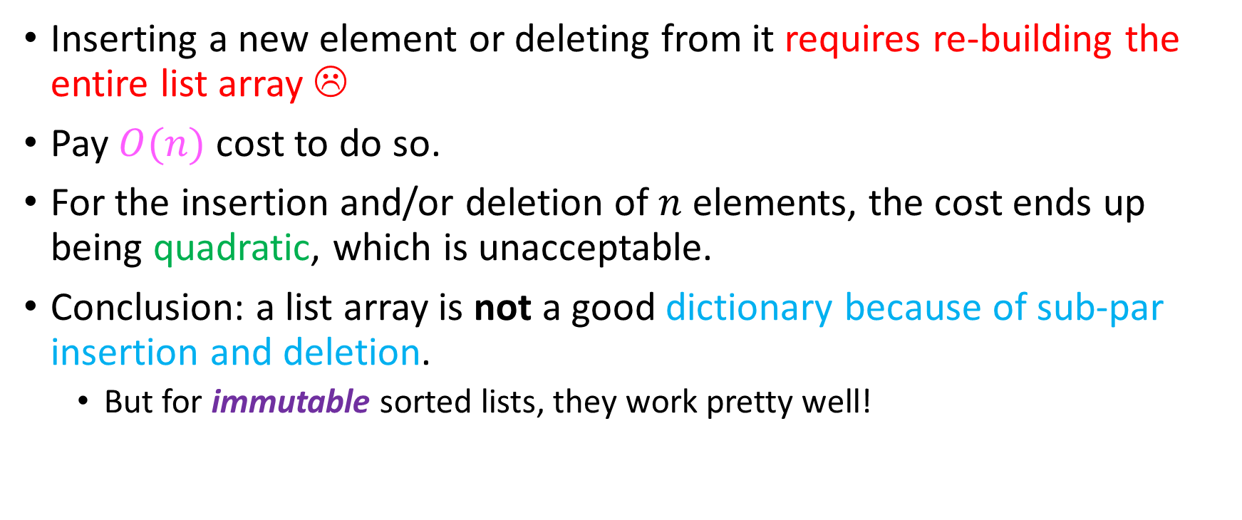
Huge issue with list arrays
Inserting a new element or deleting from it requires re-building the entire list array ☹
Pay $O(n)$cost to do so.
For the insertion and/or deletion of $n$ elements, the cost ends up being quadratic, which is unacceptable.
Conclusion: a list array is not a good dictionary because of sub-par insertion and deletion.
But for immutable sorted lists, they work pretty well!

Slide 42
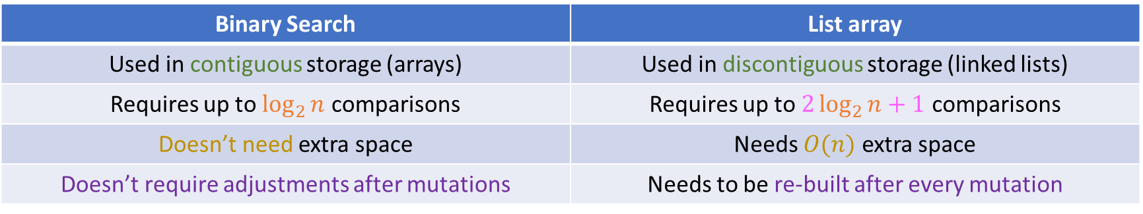
Binary Search “vs” list arrays
Binary Search | List array
Used in contiguous storage (arrays) | Used in discontiguous storage (linked lists)
Requires up to $\log_{2}{n}$ comparisons | Requires up to $2\log_{2}{n}+1$ comparisons
Doesn’t need extra space | Needs $O(n)$ extra space
Doesn’t require adjustments after mutations | Needs to be re-built after every mutation

Slide 43
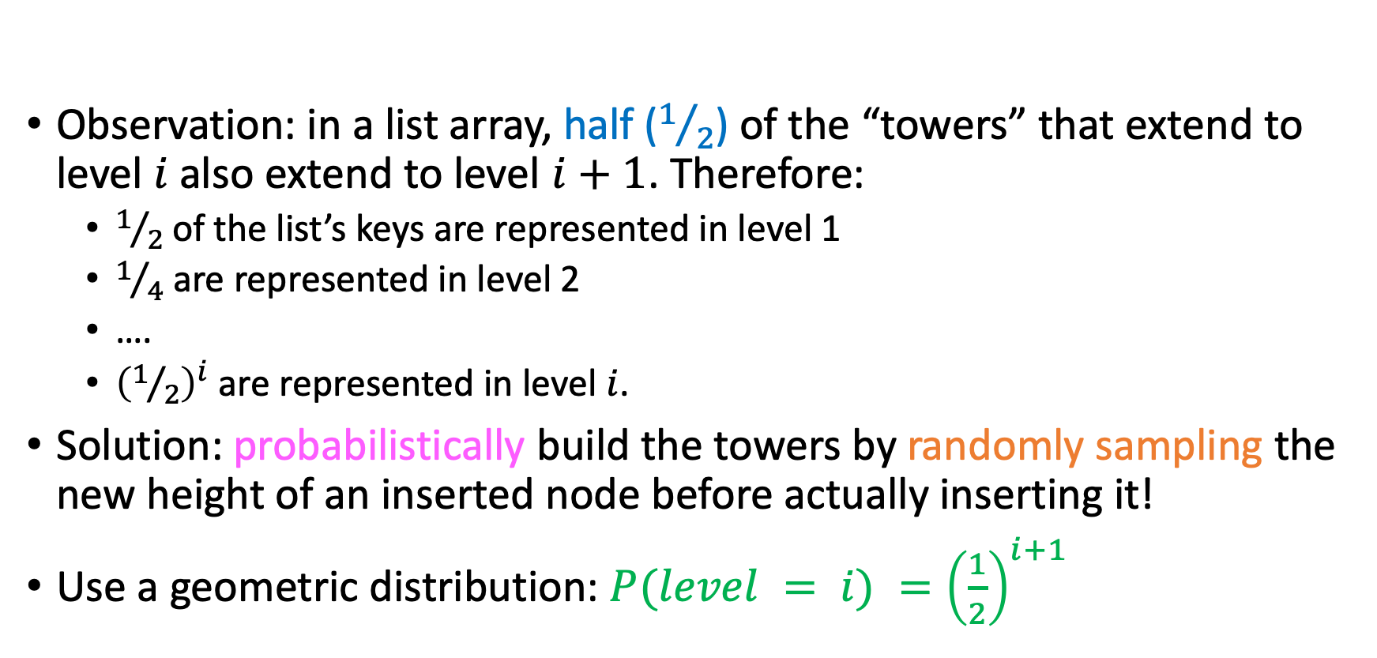
Skiplist: relaxing the constraint
Observation: in a list array, half ($1/2$) of the “towers” that extend to level $i$ also extend to level $i+1$. Therefore:
$1/2$of the list’s keys are represented in level 1
$1/4$ are represented in level 2
….
${\left(1/2\right)}^{i}$are represented in level $i$.
Solution: probabilistically build the towers by randomly sampling the new height of an inserted node before actually inserting it!
Use a geometric distribution: $P(level = i) ={\left(\frac{1}{2}\right)}^{i+1}$

Slide 44
Skiplist example
4
3
2
1
0
32
34
12
6
15
10
22
28
null

Slide 45
Skiplist example
Searching for 22 (should be a search hit)
4 | 1
3 | 2
2 | 3
1
0
32
34
4
5
12
6
6
7 15
10
8 22
28
null

Slide 46

Skiplist example
Searching for 33 (should be a search miss)
4 | 1
3
2
1
0
2
3
4
5
6 32
34
12
6
15
10
22
28
null

Slide 47

Skiplist example
It certainly looks like the height of this tower is slowing us down…
Searching for 33 (should be a search miss)
4 | 1
3
2
1
0
2
3
4
5
6 32
34
12
6
15
10
22
28
null

Slide 48
Bad skiplists
12
11
10
9
8
7
6
5
4
3
2
1
0
s
z
m
v
x
b
g
o
t
d
r
y
null

Slide 49
Bad skiplists
12
11
10
9
8
7
6
5
4
3
2
1
0
s
The green tower makes all our searches perform useless memory probes…
z
m
v
x
b
g
o
t
d
r
y
null

Slide 50
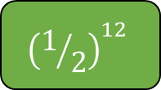
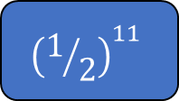
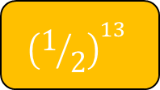
Bad skiplists
12
11
10
9
8
7
6
5
4
3
2
1
0
s
But what is the probability that we generate this tower?
$${\left(1/2\right)}^{11}$$
$${\left(1/2\right)}^{12}$$
$${\left(1/2\right)}^{13}$$
Something else (what?)
z
m
v
x
b
g
o
t
d
r
y
null

Slide 51
Bad skiplists
We have 12 flips to make the tower have 13 levels and another to keep it there!
= 0.012207031%
12
11
10
9
8
7
6
5
4
3
2
1
0
s
But what is the probability that we generate this tower?
$${\left(1/2\right)}^{11}$$
$${\left(1/2\right)}^{12}$$
$${\left(1/2\right)}^{13}$$
Something else (what?)
z
m
v
x
b
g
o
t
d
r
y
null

Slide 52
Bad skiplists
We have 12 flips to make the tower have 13 levels and another to keep it there!
= 0.012207031%
12
11
10
9
8
7
6
5
4
3
2
1
0
s
So, this is very unlikely to happen!
Even if it does, we can always maintain the current #levels and when the sampling gives us a larger height, cast that height to #levels + 1!
But what is the probability that we generate this tower?
$${\left(1/2\right)}^{11}$$
$${\left(1/2\right)}^{12}$$
$${\left(1/2\right)}^{13}$$
Something else (what?)
z
m
v
x
b
g
o
t
d
r
y
null

Slide 53
Bad skiplists
0
b
d
g
m
o
r
s
t
v
x
y
null

Slide 54
Bad skiplists
Degenerate skiplist: is equivalent to the linked list of its elements.
0
b
d
g
m
o
r
s
t
v
x
y
null

Slide 55
Bad skiplists
Degenerate skiplist: is equivalent to the linked list of its elements.
But how likely is such a skiplist?
0
b
d
g
m
o
r
s
t
v
x
y
null

Slide 56
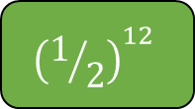

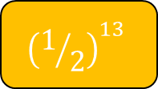
Bad skiplists
Degenerate skiplist: is equivalent to the linked list of its elements.
But how likely is such a skiplist?
$${\left(1/2\right)}^{11}$$
$${\left(1/2\right)}^{12}$$
$${\left(1/2\right)}^{13}$$
Something else (what?)
0
b
d
g
m
o
r
s
t
v
x
y
null

Slide 57
Bad skiplists
Degenerate skiplist: is equivalent to the linked list of its elements.
But how likely is such a skiplist?
Very unlikely!
$${\left(1/2\right)}^{11}$$
$${\left(1/2\right)}^{12}$$
$${\left(1/2\right)}^{13}$$
Something else (what?)
0
b
d
g
m
o
r
s
t
v
x
y
null

Slide 58
Insertion
Insertion into a skiplist follows the “search and splice” rule. Steps:

Slide 59
Insertion
Insertion into a skiplist follows the “search and splice” rule. Steps:
Randomly sample a height for the new node using a geometric distribution.

Slide 60
Insertion
Insertion into a skiplist follows the “search and splice” rule. Steps:
Randomly sample a height for the new node using a geometric distribution.
“Search” for the key in order to find the appropriate position to insert it into. While you’re descending into the skiplist, maintain a levels-sized 1D array called update which will hold the pointers from the towers that we descended from at every level.

Slide 61
Insertion
Insertion into a skiplist follows the “search and splice” rule. Steps:
Randomly sample a height for the new node using a geometric distribution.
“Search” for the key in order to find the appropriate position to insert it into. While you’re descending into the skiplist, maintain a levels-sized 1D array called update which will hold the pointers from the towers that we descended from at every level.
When you find the position, splice: insert the tower in place by using update to update the relevant pointers.

Slide 62
Insertion
Insertion into a skiplist follows the “search and splice” rule. Steps:
Randomly sample a height for the new node using a geometric distribution.
“Search” for the key in order to find the appropriate position to insert it into. While you’re descending into the skiplist, maintain a levels-sized 1D array called update which will hold the pointers from the towers that we descended from at every level.
When you find the position, splice: insert the tower in place by using update to update the relevant pointers.
We employ zero-indexing: the list level is at level 0, one level above is level 1, etc.

Slide 63
Insertion Example
4
3
2
1
0
32
34
12
6
15
10
22
28
null

Slide 64
Insertion Example
Suppose we want to insert 25.
4
3
2
1
0
32
34
12
6
15
10
22
28
null

Slide 65
Insertion Example
Task: Insert 25
Step 1: Sample a #levels “on top” of the key. Suppose we sample 3 (probability?)
4
3
2
1
0
32
34
12
6
15
10
22
28
null

Slide 66
Insertion Example
Task: Insert 25
25
Step 1: Sample a #levels “on top” of the key. Suppose we sample 3 (probability?)
32
Our new key
update
4
3
2
1
0
34
12
6
15
10
22
28
null

Slide 67
Insertion Example
Task: Insert 25
25
Step 2: Search for 25. We expect this search to fail (assuming no duplicates)
32
Our new key
update
4
3
2
1
0
34
12
6
15
10
22
28
null

Slide 68
Insertion Example
Task: Insert 25
25
32
Our new key
update
4
3
2
1
0
34
12
6
15
10
22
28
null

Slide 69
Insertion Example
Task: Insert 25
25
32
Our new key
update
4
3
2
1
0
34
12
6
15
10
22
28
null

Slide 70
Insertion Example
Task: Insert 25
25
We don’t have to touch update yet, since the current #levels is 4, greater than that of the key (slightly different approach from Schaffer)
32
Our new key
update
4
3
2
1
0
34
12
6
15
10
22
28
null

Slide 71
Insertion Example
Task: Insert 25
25
32
Our new key
update
4
3
2
1
0
34
12
6
15
10
22
28
null

Slide 72
Insertion Example
Task: Insert 25
25
32
Our new key
update
4
3
2
1
0
34
12
6
15
10
22
28
null

Slide 73
Insertion Example
Task: Insert 25
25
Now, however, we should touch the update array, since we are at a level (3) where pointers will need to be adjusted after insertion….
32
Our new key
update
4
3
2
1
0
34
12
6
15
10
22
28
null

Slide 74
Insertion Example
Task: Insert 25
25
32
Our new key
update
4
3
2
1
0
34
12
6
15
10
22
28
null

Slide 75

Insertion Example
Task: Insert 25
25
12 is smaller than 25, so we can keep going on this level: it’s not time to touch “update” yet!
32
Our new key
update
4
3
2
1
0
34
12
6
15
10
22
28
null

Slide 76
Insertion Example
Task: Insert 25
25
32
Our new key
update
4
3
2
1
0
34
12
6
15
10
22
28
null

Slide 77
Insertion Example
Task: Insert 25
25
32
Our new key
update
4
3
2
1
0
34
12
6
15
10
22
28
null

Slide 78
Insertion Example
Task: Insert 25
25
Now it’s time to write into update again….
32
Our new key
update
4
3
2
1
0
34
12
6
15
10
22
28
null

Slide 79
Insertion Example
Task: Insert 25
25
32
Our new key
update
4
3
2
1
0
34
12
6
15
10
22
28
null

Slide 80

Insertion Example
Task: Insert 25
25
32
Our new key
update
4
3
2
1
0
34
12
6
15
10
22
28
null

Slide 81
Insertion Example
Task: Insert 25
25
32
Our new key
update
4
3
2
1
0
34
12
6
15
10
22
28
null

Slide 82
Insertion Example
Task: Insert 25
25
32
Our new key
update
4
3
2
1
0
34
12
6
15
10
22
28
null

Slide 83
Insertion Example
Task: Insert 25
25
Let’s not forget to write into update…
32
Our new key
update
4
3
2
1
0
34
12
6
15
10
22
28
null

Slide 84
Insertion Example
Task: Insert 25
25
32
Our new key
update
4
3
2
1
0
34
12
6
15
10
22
28
null

Slide 85

Insertion Example
Task: Insert 25
25
22 < 25, keep going….
32
Our new key
update
4
3
2
1
0
34
12
6
15
10
22
28
null

Slide 86
Insertion Example
Task: Insert 25
25
32
Our new key
update
4
3
2
1
0
34
12
6
15
10
22
28
null

Slide 87
Insertion Example
Task: Insert 25
25
32
Our new key
update
4
3
2
1
0
34
12
6
15
10
22
28
null

Slide 88
Insertion Example
Task: Insert 25
25
Write into update…
32
Our new key
update
4
3
2
1
0
34
12
6
15
10
22
28
null

Slide 89
Insertion Example
Task: Insert 25
25
Step 3: Splice the new tower in place by using update array.
32
Our new key
update
4
3
2
1
0
34
12
6
15
10
22
28
null

Slide 90
Insertion Example
Task: Insert 25
Step 3: Splice the new tower in place by using update array.
(a) Make all the forward pointers of the new key point wherever the nodes stored in update were pointing….
32
update
4
3
2
1
0
25
34
12
6
15
10
22
28
Our new key
null

Slide 91
Insertion Example
Task: Insert 25
Step 3: Splice the new tower in place by using update array.
(b) … and make sure that the nodes stored in update now point to the new key.
32
update
4
3
2
1
0
25
34
12
6
15
10
22
28
Our new key
null

Slide 92
Insertion Example
Task: Insert 25
Done! ☺
32
4
3
2
1
0
25
34
12
6
15
10
22
28
null

Slide 93
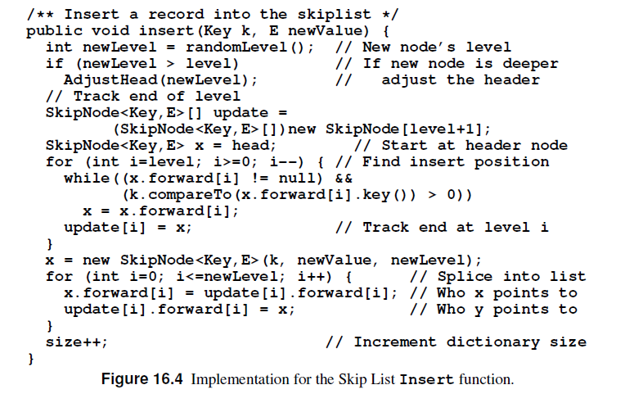
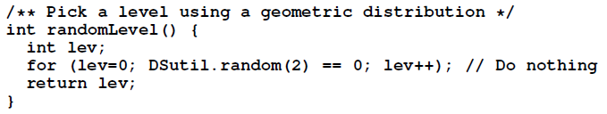
Live insertion demo!
Using only the pseudocode from Shaffer’s book (p. 519 in the Java edition) and a coin, let’s see if we can insert some ints into an initially empty Skiplist!

Slide 94
Skiplist insertion demo!

Slide 95

Worksheet exercise!

Slide 96
Deletion
Deletion works very much like insertion.
Two differences:
We don’t have a need to sample a height.
We use the information in the update array differently: instead of connecting nodes “before” the new tower to it and connecting the new tower to subsequent towers, we remove the existing pointers.

Slide 97
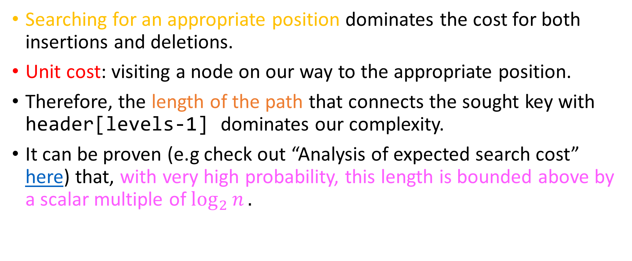
Analysis
Searching for an appropriate position dominates the cost for both insertions and deletions.
Unit cost: visiting a node on our way to the appropriate position.
Therefore, the length of the path that connects the sought key with header[levels-1] dominates our complexity.
It can be proven (e.g check out “Analysis of expected search cost” here) that, with very high probability, this length is bounded above by a scalar multiple of $\log_{2}{n}.$

Slide 98

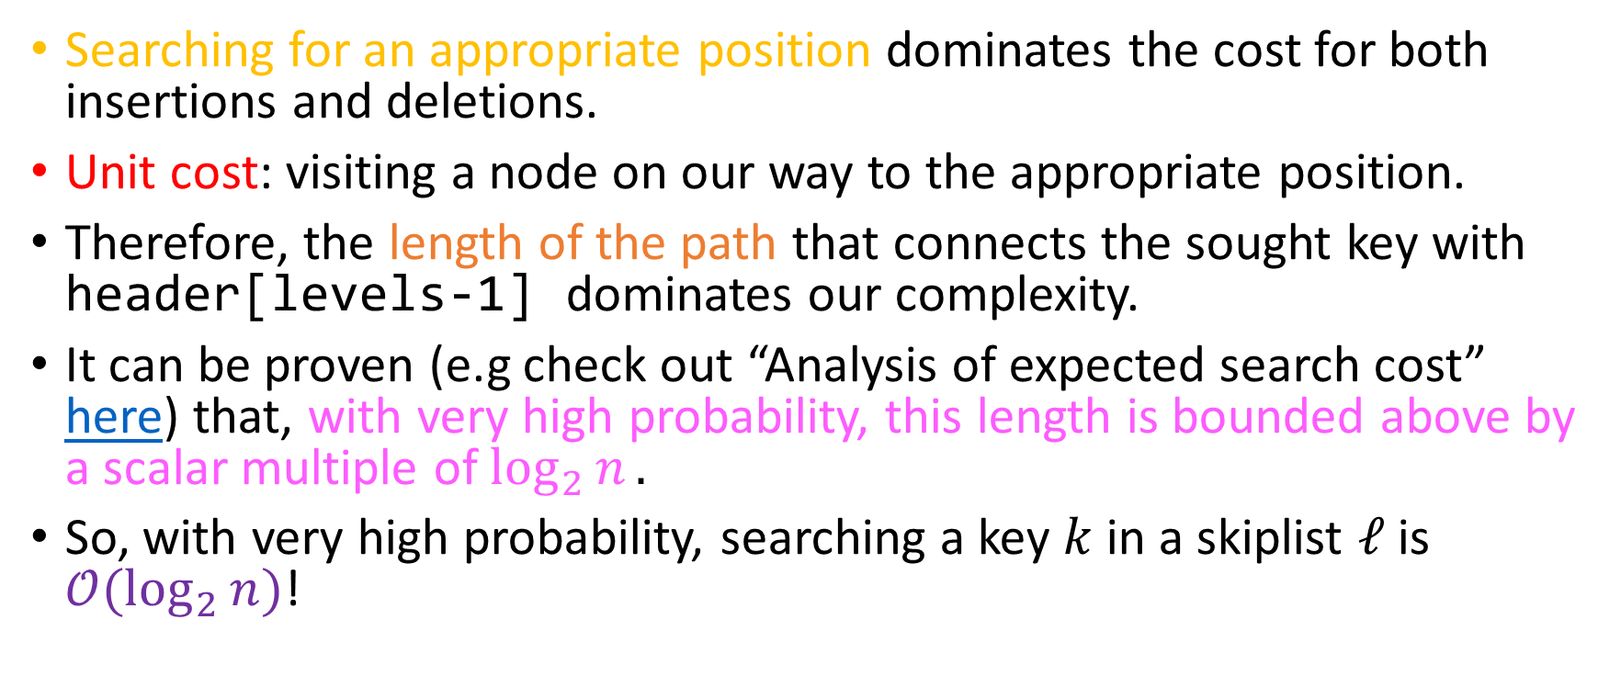
Analysis
Searching for an appropriate position dominates the cost for both insertions and deletions.
Unit cost: visiting a node on our way to the appropriate position.
Therefore, the length of the path that connects the sought key with header[levels-1] dominates our complexity.
It can be proven (e.g check out “Analysis of expected search cost” here) that, with very high probability, this length is bounded above by a scalar multiple of $\log_{2}{n}.$
So, with very high probability, searching a key $k$ in a skiplist $ℓ$ is $𝒪(\log_{2}{n)}$!

Slide 99
Why skiplists?
Excellent distributed performance.
Lock-free implementations exist
E.g check out Java’s ConcurrentSkipListMap, ConcurrentSkipListSet
Compare with AVL trees and Red-Black trees where locking entire paths or even the entire tree might be necessary because of successive rotations.
Local updates ensure that you only need to lock the tower after the one you splice into!

Slide 100
Why skiplists?
Insensitivity on insertion order.
AVL + Red-Black trees might make balance guarantees, but a bad insertion order can affect performance of insertions!
Ease of implementation
No recursion overhead: core of search algorithm is a double loop (while inside a for)
Linearity of data and local updates allow for distribution of data across nodes (very good horizontal scalability)
Compare with AVL and Red-Black trees where storing different subtrees in different nodes might make it hard to propagate rotations from one subtree to the other.

Slide 101
Disadvantages of skiplists
Probabilistic instead of deterministic guarantees
Compare with AVL and Red-Black trees which offer guarantees of $\log_{2}{n}$ and ${2⋅log}_{2}{n}$ respectively.

Slide 102
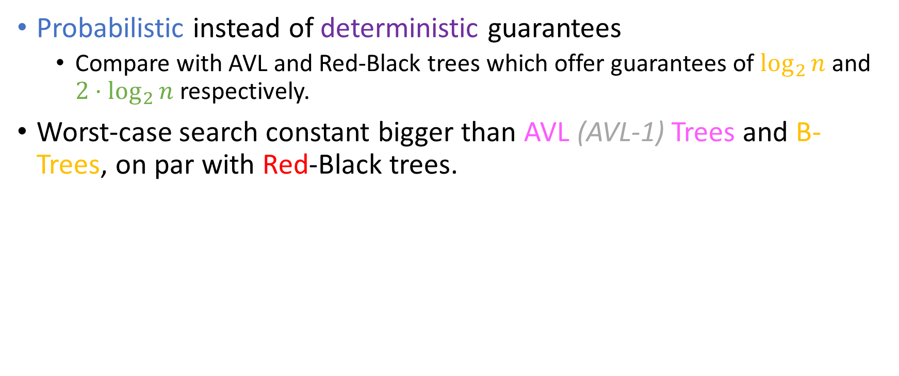
Disadvantages of skiplists
Probabilistic instead of deterministic guarantees
Compare with AVL and Red-Black trees which offer guarantees of $\log_{2}{n}$ and ${2⋅log}_{2}{n}$ respectively.
Worst-case search constant bigger than AVL (AVL-1) Trees and B-Trees, on par with Red-Black trees.

